Slide 1
Search, Relevance, and Recommendation for Wine Reviews
CS-410 Fall 23’
qinxiw2@illinois.edu
Notes:
Search and Recs on reviews

Slide 2
Roadmap
Motivation
Data Exploration
Sentiment Analysis
Recommender System
Search and Retrieval
Topic Identification
Software Usage Tutorial
Discussion

Slide 3
Motivation
Combine and utilize various things we have learned this semester, including search, retrieval and ranking, NLP techniques, text classification/categorization, and recommendations:
1) Search wine by description using free text;
2) Categorize reviews by positive, neutral, or critica sentiment;
3) Retrieve relevant wine search by variety, country, designation, etc;
4) Recommend similar wines matched via content based aon review and attribute similarities
Notes:
search and recommendations around wine based on their attributes and reviews. The task is to build a program that support the following functionalities: 1) Search wine by description using free text; 2) Categorize reviews by positive, neutral, or critica sentiment; 3) Retrieve relevant wine search by variety, country, designation, etc; 3) Select a wine and click recommend similar wines via content based and collaborative filtering, and tree-based models to learn bias / weights on various discriminative features.
The main selling point of the project is to combine and utilize various things we have learned this semester, including search, retrieval and ranking, NLP techniques, text classification/categorization, and recommendations. This is attractive and unique because there is no existing system that applies all these on the dataset and provides all the functionalities listed above.

Slide 4
Prerequisite on installation
git clone https://github.com/QinxiW/TISProject.git
Then from the root dir….
Create a python 3.11 virtualenv
python3 -m venv myenv
Activate the virtualenv
source myenv/bin/activate
Install all the necessarily libraries needed
pip install -r requirements.txt

Slide 5
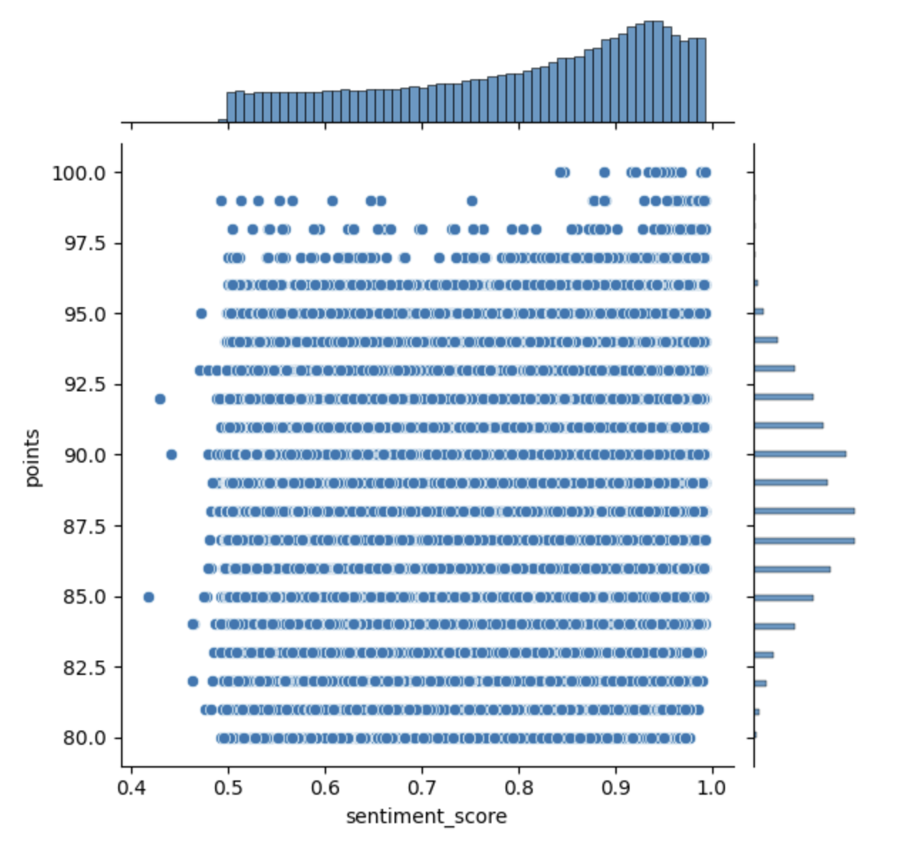
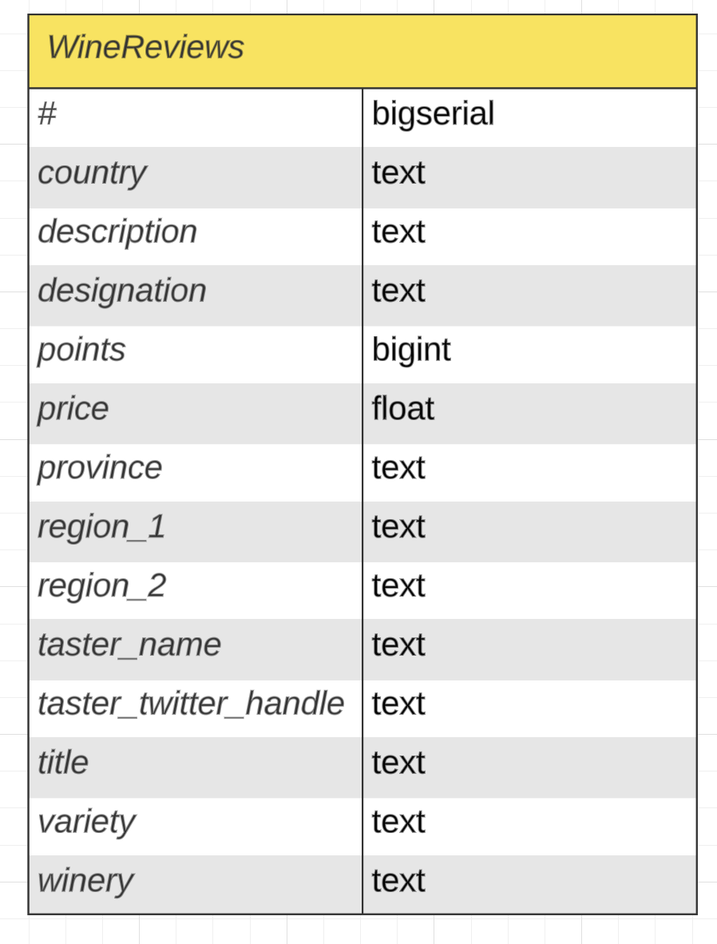
2. Data Exploration
python Data/data_cleaning.py –- file_location_path {dataset}
Notes:
We began with data exploration, we performed standard cleaning tasks such as checking duplicates, filling Nan values, and ensuring the data of the same column share the same data types. We also attempted to fill missing values at this stage, such as by extracting wine year from the title, level geographic fields by existing records, and impute price info. The most significant contribution and implementation of our software at this stage is the text processing and cleaning, where we first tokenized the fields with word and sentence tokenizer, then checked spelling and removed overly long or short words, and stopwords. We then lemmatized the words, and dropped numerical and non-english words from the reviews.

Slide 6
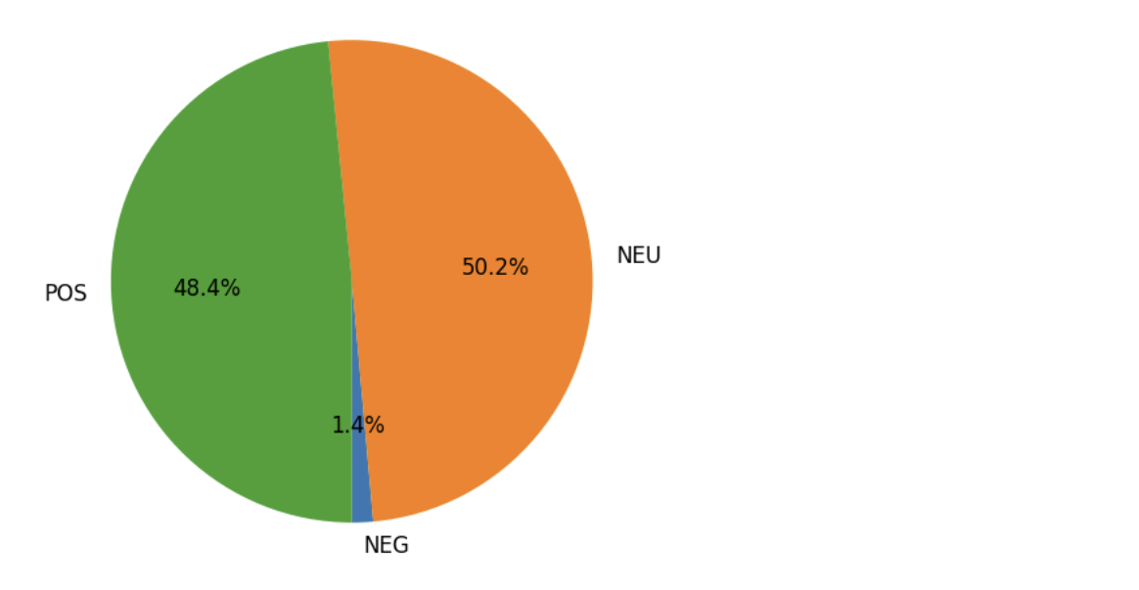
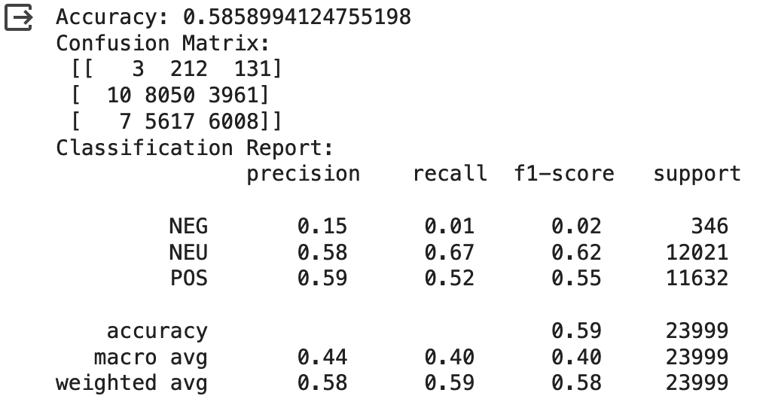
3. Sentiment Analysis
python Model/sentiment_analysis_and_fine_tuning.py
Notes:
After that we implemented the sentiment analysis and fine-tuning task. Per our proposal plan, we surveyed and picked a pre-trained sentiment analyser model most suitable for our dataset, and then applied fine tune and transfer learning on top using the dataset we have. The purpose of sentiment analysis is two folds - one is to understand the opinions included in the wine dataset better, and see if there’s correlation between wine attributes and sentiment; the other is we believe sentiments can play a role in text feature based recommendations, so we want to utilize sentiment as a signal to compare different wines for similarities. Since our dataset itself does not have labels suitable for training a sentiment classifier from scratch, we applied fine-tuning with a test and train set we sampled from the dataset and used points as proxy.

Slide 7
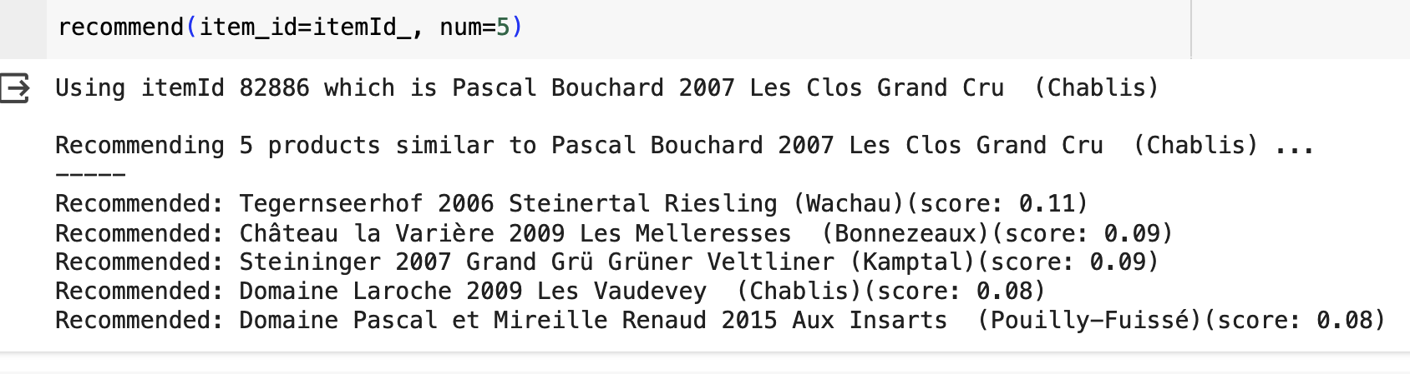
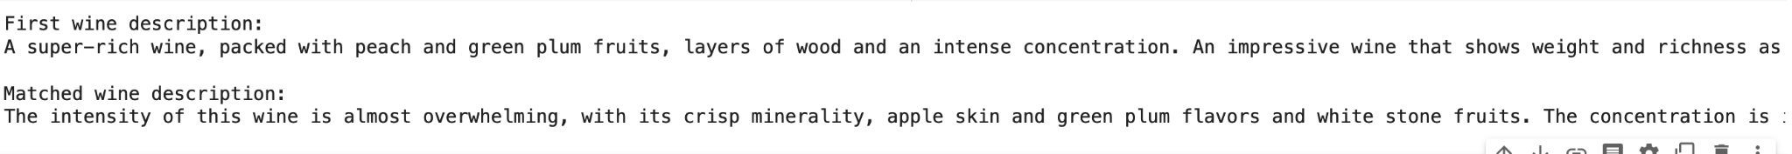
4. Recommender System - Collaborative Filtering
python Model/cf_recommender.py
Notes:
By now we had everything we needed to go into recommender system implementation, here the software is implemented by two stages. First stage is offline modeling and evaluation. At this stage all the code was first sandboxed in the data exploration notebook, we implemented various classic recommender systems, including collaborative filtering, discriminative model, instance-based learning algorithm, and text to embedding feature. From there we picked three most promising types of each to prototype - collaborative filtering using SVD, k-nearest neighbor, and random forest. We cleaned up the code and combined training, evaluation, and model and artifacts saving into their corresponding file under Model. The second stage of recommendation is online inference. We have the recommendation model and their artifacts created and stored along in the Search/ dir, where the search match results will invoke these models to be loaded into memory if have not already, and take in the matched wine as input, and perform necessary pre-processing, lookup, similarity calculation for recs, along with search recommendation for refined search or pattern mining from the wine reviews for user discovery.

Slide 8
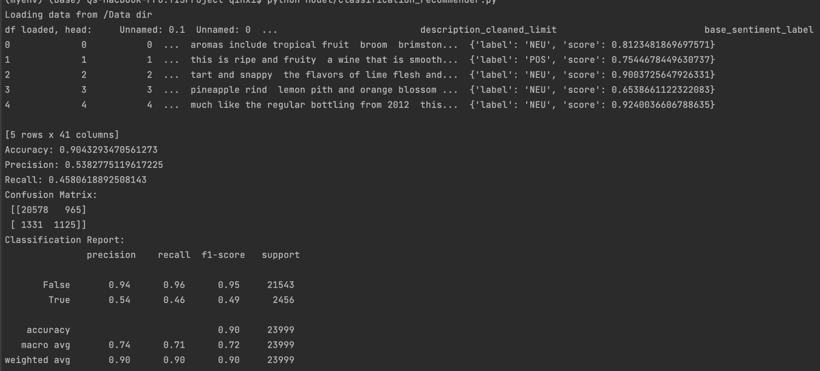
4. Recommender System - Random Forest
python Model/rf_recommender.py
Notes:
By now we had everything we needed to go into recommender system implementation, here the software is implemented by two stages. First stage is offline modeling and evaluation. At this stage all the code was first sandboxed in the data exploration notebook, we implemented various classic recommender systems, including collaborative filtering, discriminative model, instance-based learning algorithm, and text to embedding feature. From there we picked three most promising types of each to prototype - collaborative filtering using SVD, k-nearest neighbor, and random forest. We cleaned up the code and combined training, evaluation, and model and artifacts saving into their corresponding file under Model. The second stage of recommendation is online inference. We have the recommendation model and their artifacts created and stored along in the Search/ dir, where the search match results will invoke these models to be loaded into memory if have not already, and take in the matched wine as input, and perform necessary pre-processing, lookup, similarity calculation for recs, along with search recommendation for refined search or pattern mining from the wine reviews for user discovery.

Slide 9
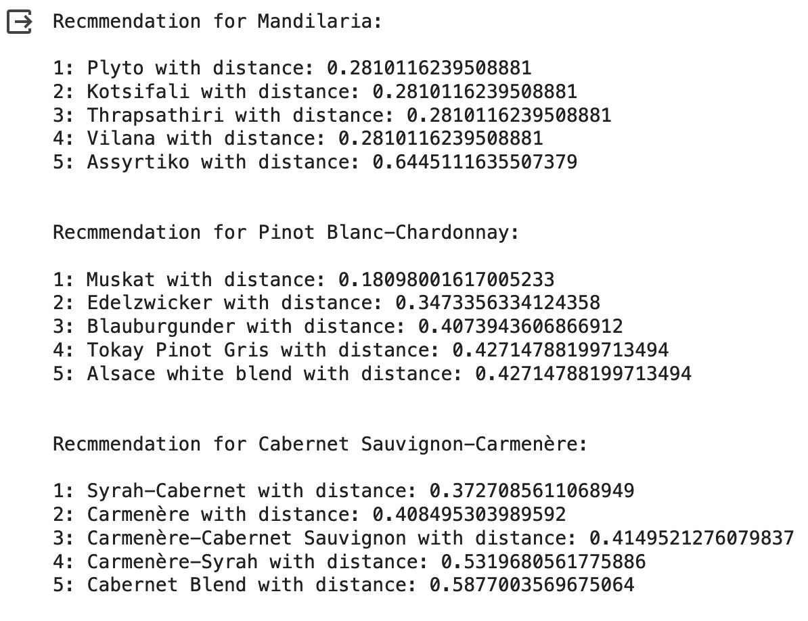
4. Recommender System - k-nearest neighbors
python Model/knn_recommender.py
Notes:
By now we had everything we needed to go into recommender system implementation, here the software is implemented by two stages. First stage is offline modeling and evaluation. At this stage all the code was first sandboxed in the data exploration notebook, we implemented various classic recommender systems, including collaborative filtering, discriminative model, instance-based learning algorithm, and text to embedding feature. From there we picked three most promising types of each to prototype - collaborative filtering using SVD, k-nearest neighbor, and random forest. We cleaned up the code and combined training, evaluation, and model and artifacts saving into their corresponding file under Model. The second stage of recommendation is online inference. We have the recommendation model and their artifacts created and stored along in the Search/ dir, where the search match results will invoke these models to be loaded into memory if have not already, and take in the matched wine as input, and perform necessary pre-processing, lookup, similarity calculation for recs, along with search recommendation for refined search or pattern mining from the wine reviews for user discovery.

Slide 10
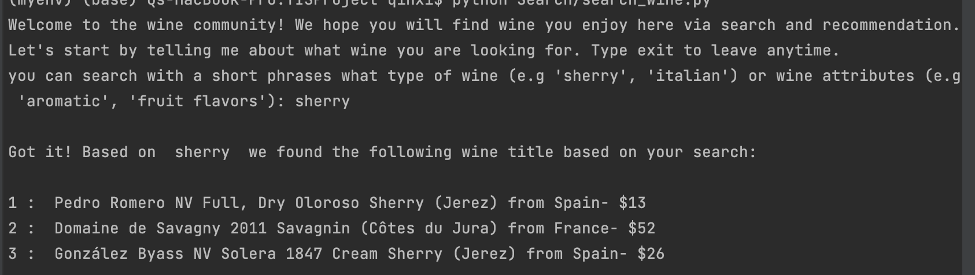
5. Search & Retrieval
python Search/wine_search.py
Notes:
We stretched out search functionality after that. We tried a few libraries for that, weighing search accuracy and retrieval speed. We landed on using fuzz function from rapidfuzz library, which yielded the best performance compared other libraries as well as our inhouse implementation. The search wine part is implemented with user interaction in mind, the program starts by prompting users to search for a wine title, attributes, or other short phrases they’d like to find wine that match the criteria, then search through multiple columns such as reviews, variety, winery, region, etc to find best matching wines. Then from there it will evoke the recommendations software described below, to retrieve similar wines we think the user is going to like based on their search, and other search phrase suggestions if they liked what they see.

Slide 11
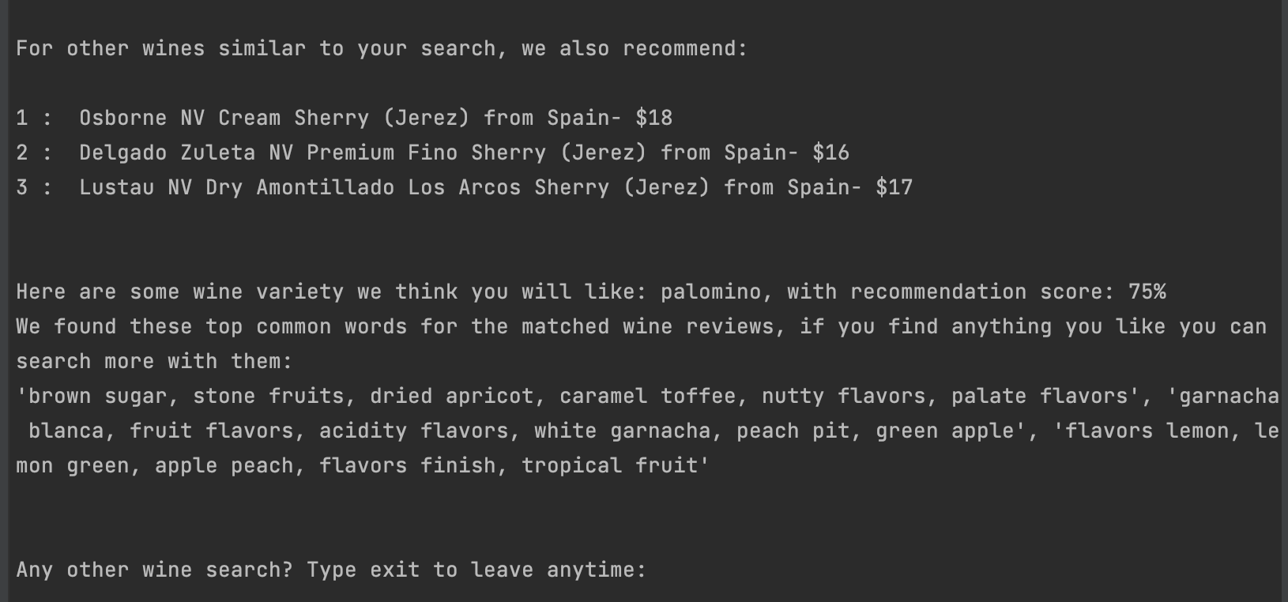
6. Topic Identification & Suggestion
python Search/wine_inference.py

Slide 12
7. Software Usage Tutorial - Demo
Notes:
(2) sufficient instructions on how to use the software, and
(3) at least one example of use case so as to allow a grader to use the provided use case to test the software.

Slide 13
8. Discussion
Accomplishments
We built an interactive program that allows search and other exploratory activities with the wine and their attributes(variety, region, etc) and reviews.
Observations
Lack labeled data for accurate metrics in evaluation, hard to compare different models
Next steps
Gather user feedback and add instrumentation of online metrics
Use user feedback to run transfer learning

